Slide 1
Communication Security: Message Confidentiality & Symmetric Encryption CS-4440 - Introduction to Computer Security Spring 2022 Jun Xu Slides adapted from Cliff C. Zou’s CIS-3360 at UCF

Slide 2


Model of Computer Communication
data, control messages
Alice
Bob
channel
sender
receiver
data
data

Slide 3

Threat Model of Secure Communication
data, control messages
Alice
Bob
channel
sender
receiver
data
data
Eve
Eavesdropping
Manipulating
Camouflaging

Slide 4

Encryption: Defeating Eavesdropping
plaintext
encryption
algorithm
ciphertext
decryption
algorithm
plaintext
Eve

Slide 5
The Language of Cryptography
K
Alice’s
encryption
key
A
Bob’s
decryption
key
K
B
plaintext
encryption
algorithm
ciphertext
decryption
algorithm
plaintext
Eve
Symmetric key crypto: sender, receiver keys identical
Public-key crypto: encryption key public, decryption key secret (private)

Slide 6
Symmetric Cryptosystem
Scenario
-- Alice wants to send a message (plaintext P) to Bob.
-- The communication channel is insecure and can be eavesdropped
-- If Alice and Bob have previously agreed on a symmetric encryption scheme and a secret key K, the message can be sent encrypted (ciphertext C)
Question:
-- What is a good symmetric encryption scheme? What are the metrics?

Slide 7
Preliminaries
Notations
Secret key K
Encryption function E_{K}(P); Must be published
Decryption function D_{K}(C); Must be published
Plaintext length typically the same as ciphertext length
Correctness
Encryption and decryption are one-one mapping functions on the set of all n-bit arrays
Decrypting the ciphertext yields the plaintext: D_{K}(E_{K}(P)) = P
Efficiency
- Functions E_{K} and D_{K} should have efficient algorithms
Security
- Robust against common attacks

Slide 8
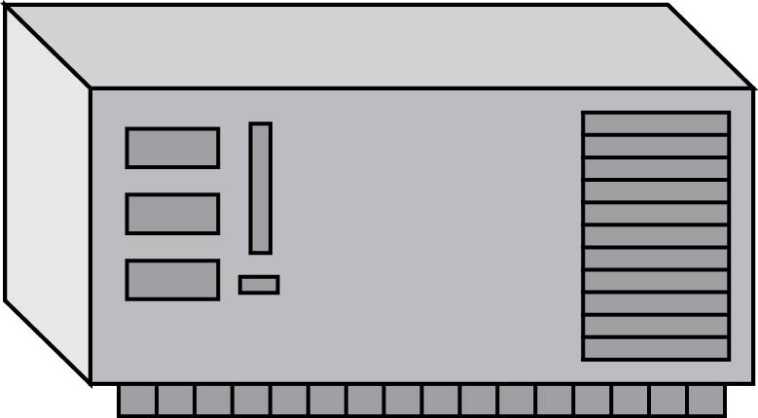





What can the attackers do?
Plaintext
Encryption
Algorithm
Ciphertext
Hi, Bob.
Don’t invite Eve to the party!
Love, Alice
(a)
Attacker may have
collection of ciphertexts (ciphertext only attack)
collection of plaintext/ciphertext pairs (known plaintext attack)
collection of plaintext/ciphertext pairs for plaintexts selected by the attacker (chosen plaintext attack)
collection of plaintext/ciphertext pairs for ciphertexts selected by the attacker (chosen ciphertext attack)
key
Eve
Plaintext
Encryption
Algorithm
Ciphertext
Hi, Bob.
Don’t invite Eve to the party!
Love, Alice
(b)
key
Plaintext
Eve
Ciphertext
ABCDEFG
HIJKLMNO
PQRSTUV
WXYZ.
Encryption
Algorithm
(c)
key
Plaintext
Encryption
Algorithm
Eve
Ciphertext
IJCGA, CAN DO HIFFA GOT TIME.
001101
110111
(d)
key
Eve
Eve

Slide 9
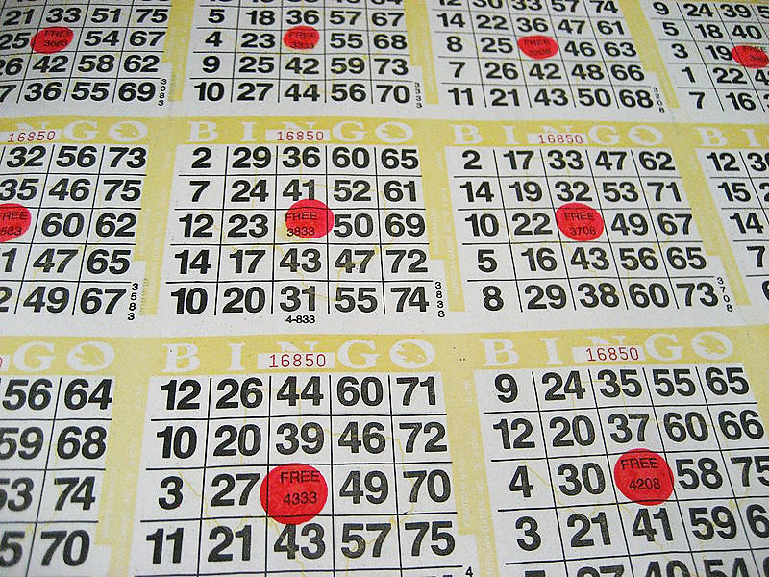
Brute-Force Attack: A Classical Example
Assuming a piece of cyphertext C is available, try all possible keys K and determine if D_{K}(C) is a likely plaintext
- Requires some knowledge of the plaintext
Image by Michael Cote from http://commons.wikimedia.org/wiki/File:Bingo_cards.jpg

Slide 10
Example 1: Transposition Cipher: Rail Fence
Write plaintext in two rows
Generate ciphertext in column order
Example: “HELLOWORLD”
HLOOL
ELWRD
ciphertext: HLOOLELWRD
Problem: ???
No key is used!!!

Slide 11
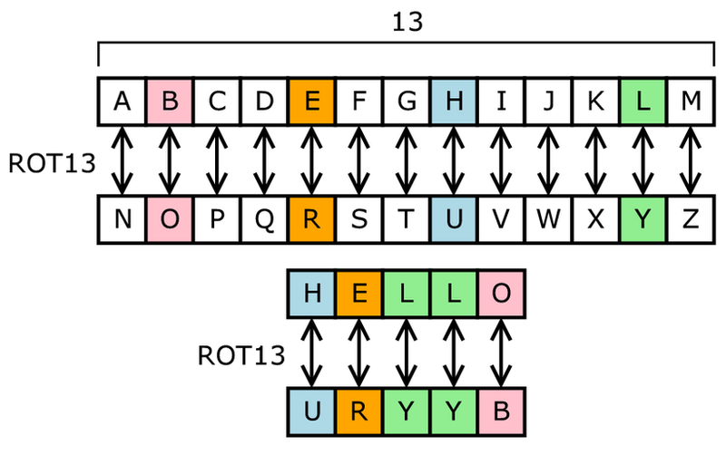
Example 1I: Substitution Ciphers: Caesar Cipher
Each letter is uniquely replaced by another.
There are 26! possible substitution ciphers for English
There are more than 4.03 x 10²⁶ such ciphers.
One popular substitution “cipher” for some Internet posts is ROT13.

Slide 12
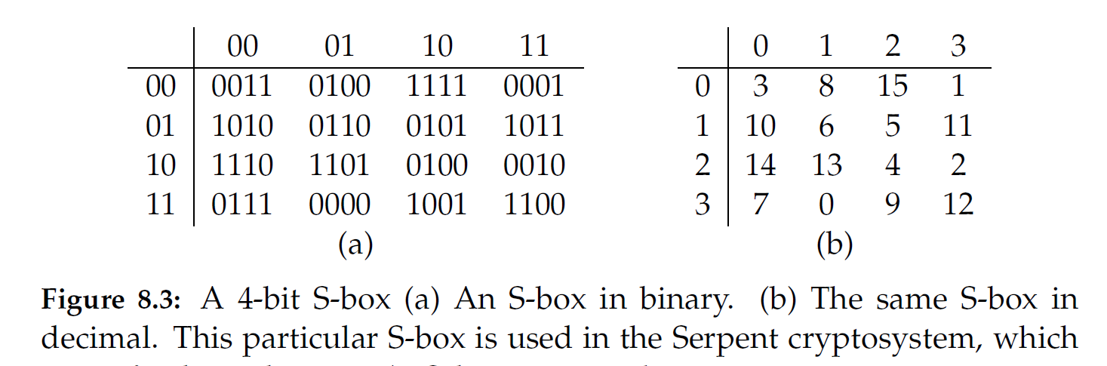
Substitution Boxes
Substitution can also be done on binary numbers.
Such substitutions are usually described by substitution boxes, or S-boxes.
Problem: ???

Slide 13
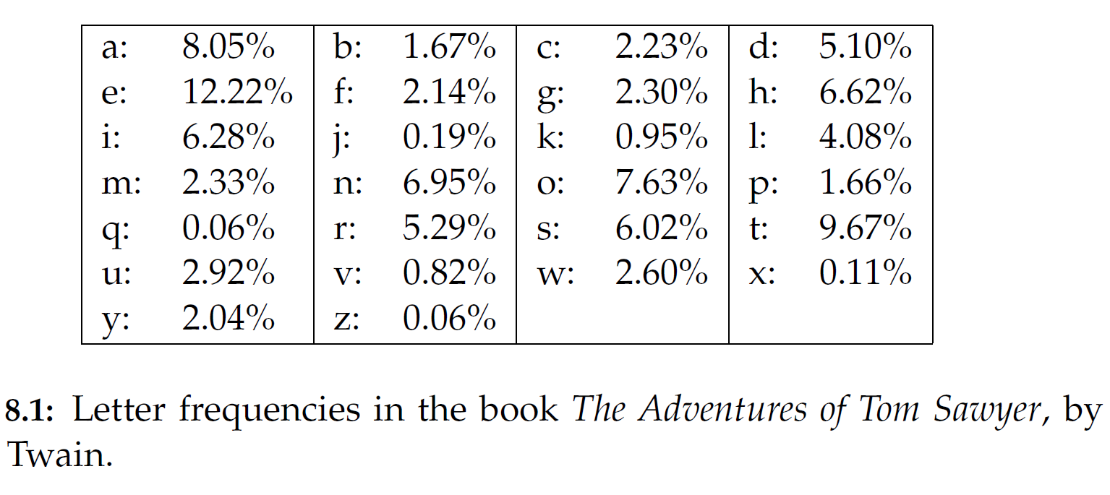
Frequency Analysis
Letters in natural languages, like English, are not uniformly distributed.
Knowledge of letter frequencies, including pairs and triples can be used to attack substitution ciphers.

Slide 14
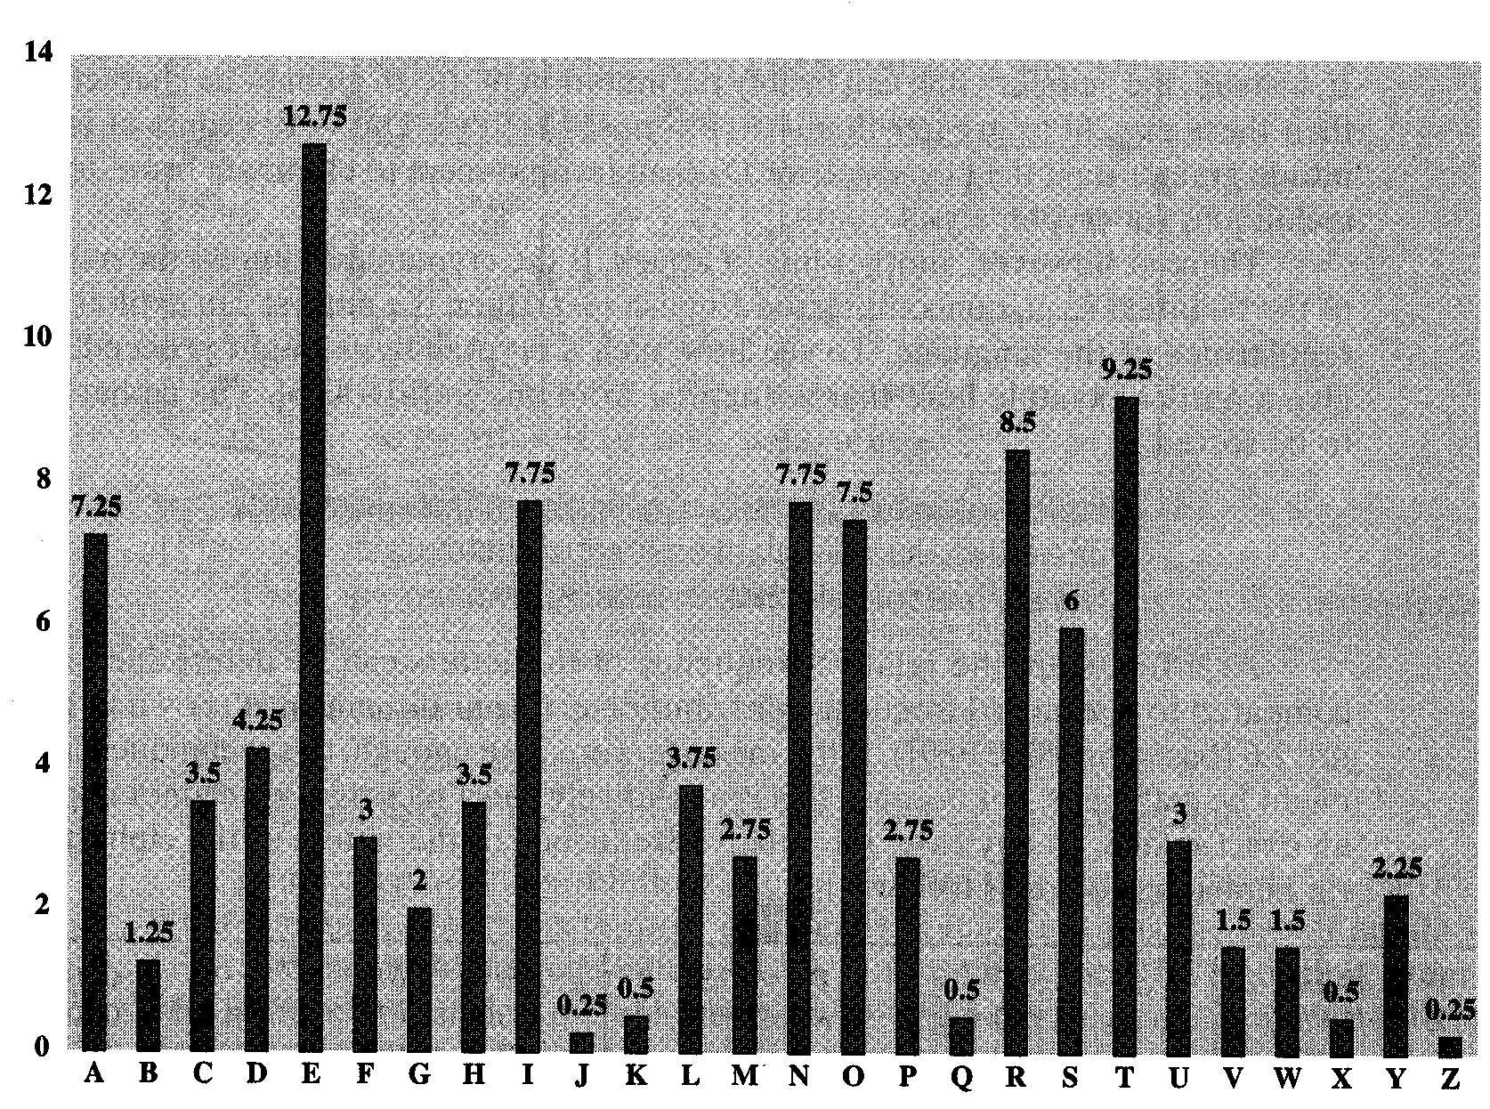
Frequency of Letters in English

Slide 15
Vigenere Cipher
Idea: Uses Caesar's cipher with various different shifts, in order to hide the distribution of the letters.
A key defines the shift used in each letter in the text
A key word is repeated as many times as required to become the same length
Plain text: I a t t a c k
Key: 2 3 4 2 3 4 2 (key is “234”)
Cipher text: K d x v d g m

Slide 16
Problem of Vigenere Cipher
Vigenere is easy to break (Kasiski, 1863):
Assume we know the length of the key. We can organize the ciphertext in rows with the same length of the key. Then, every column can be seen as encrypted using Caesar's cipher.
The length of the key can be found using several methods:
1. If short, try 1, 2, 3, . . . .
2. Find repeated strings in the ciphertext. Their distance is expected to be a multiple of the length. Compute the gcd of (most) distances.
3. Use the index of coincidence (https://en.wikipedia.org/wiki/Index_of_coincidence).

Slide 17
One-Time Pads
Extended from Vigenere cipher
There is one type of substitution cipher that is absolutely unbreakable.
The one-time pad was invented in 1917 by Joseph Mauborgne and Gilbert Vernam
We use a block of shift keys, (k₁, k₂, . . . , k_{n}), to encrypt a plaintext, M, of length n, with each shift key being chosen uniformly at random.
Since each shift is random, every ciphertext is equally likely for any plaintext.
Problem: ???

Slide 18
Weaknesses of the One-Time Pad
Despite their perfect security, one-time pads have some weaknesses
The key has to be as long as the plaintext
Keys can never be reused
Synchronizations of keys are tricky (quantum communication)?

Slide 19
Today: Block Ciphers
In a block cipher:
Plaintext and ciphertext have fixed length b (e.g., 128 bits)
A plaintext of length n is partitioned into a sequence of m blocks, P[0], …, P[m−1], where n ≤ bm < n + b
Each message is divided into a sequence of blocks and encrypted or decrypted in terms of its blocks.
Requires padding
with extra bits.
Plaintext
Blocks of
plaintext

Slide 20
Padding
Block ciphers require the length n of the plaintext to be a multiple of the block size b
Padding the last block needs to be unambiguous (cannot just add zeroes)
When the block size and plaintext length are a multiple of 8, a common padding method (PKCS5) is a sequence of identical bytes, each indicating the length (in bytes) of the padding
Example for b = 128 (16 bytes)
Plaintext: “Roberto” (7 bytes)
Padded plaintext: “Roberto999999999” (16 bytes), where 9 denotes the number and not the character
We need to always pad the last block, which may consist only of padding

Slide 21
Block Ciphers in Practice
Data Encryption Standard (DES)
Developed by IBM and adopted by NIST in 1977
64-bit blocks and 56-bit keys
Small key space makes exhaustive search attack feasible since late 90s
Triple DES (3DES)
Nested application of DES with three different keys KA, KB, and KC
Effective key length is 168 bits, making exhaustive search attacks unfeasible
C = E_{KC}(D_{KB}(E_{KA}(P))); P = D_{KA}(E_{KB}(D_{KC}(C)))
Equivalent to DES when KA=KB=KC (backward compatible)
Advanced Encryption Standard (AES)
Selected by NIST in 2001 through open international competition and public discussion
128-bit blocks and several possible key lengths: 128, 192 and 256 bits
Exhaustive search attack not currently possible
AES-256 is the symmetric encryption algorithm of choice

Slide 22
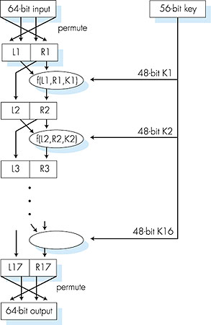
Symmetric key crypto: DES
DES operation
initial permutation
16 identical “rounds” of function application, each using different 48 bits of key
final permutation

Slide 23
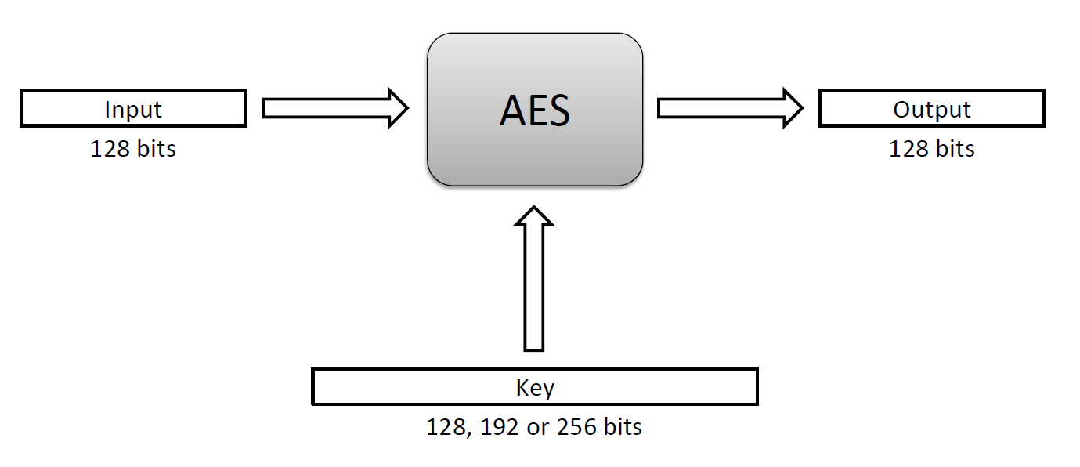
The Advanced Encryption Standard (AES)
In 1997, the U.S. National Institute for Standards and Technology (NIST) put out a public call for a replacement to DES.
It narrowed down the list of submissions to five finalists, and ultimately chose an algorithm that is now known as the Advanced Encryption Standard (AES).
AES is a block cipher that operates on 128-bit blocks. It is designed to be used with keys that are 128, 192, or 256 bits long, yielding ciphers known as AES-128, AES-192, and AES-256.

Slide 24
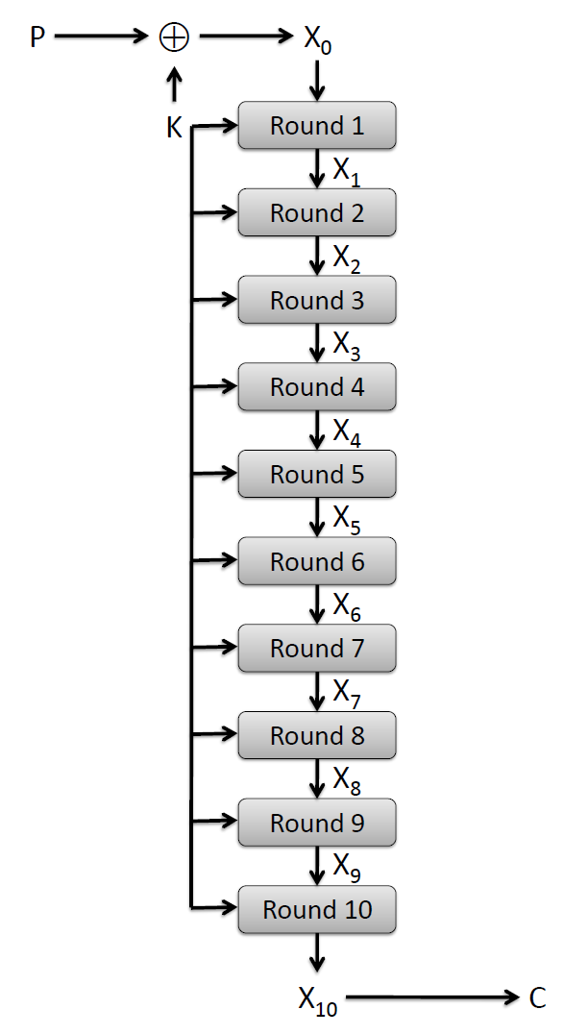
AES Round Structure
The 128-bit version of the AES encryption algorithm proceeds in ten rounds.
Each round performs an invertible transformation on a 128-bit array, called state.
The initial state X₀ is the XOR of the plaintext P with the key K:
X₀ = P XOR K.
Round i (i = 1, …, 10) receives state X_{i-1} as input and produces state X_{i}.
The ciphertext C is the output of the final round: C = X₁₀.

Slide 25
AES Rounds
Each round is built from four basic steps:
SubBytes step: an S-box substitution step (no key is used)
ShiftRows step: a permutation step (no key is used)
MixColumns step: a matrix multiplication step (no key is used)
AddRoundKey step: an XOR step with a round key derived from the 128-bit encryption key

Slide 26
Block Cipher Modes
Assuming you have multiple blocks to encrypt, what are you going to do? How do you encrypt and decrypt a sequence of message blocks.

Slide 27
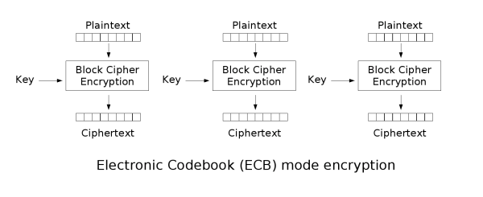
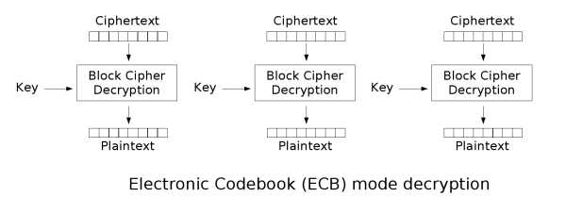
Electronic Code Book
Electronic Code Book (ECB) Mode (is the simplest):
Block P[i] encrypted into ciphertext block C[i] = E_{K}(P[i])
Block C[i] decrypted into plaintext block M[i] = D_{K}(C[i])
Public domain images from http://en.wikipedia.org/wiki/File:Ecb_encryption.png and http://en.wikipedia.org/wiki/File:Ecb_decryption.png

Slide 28
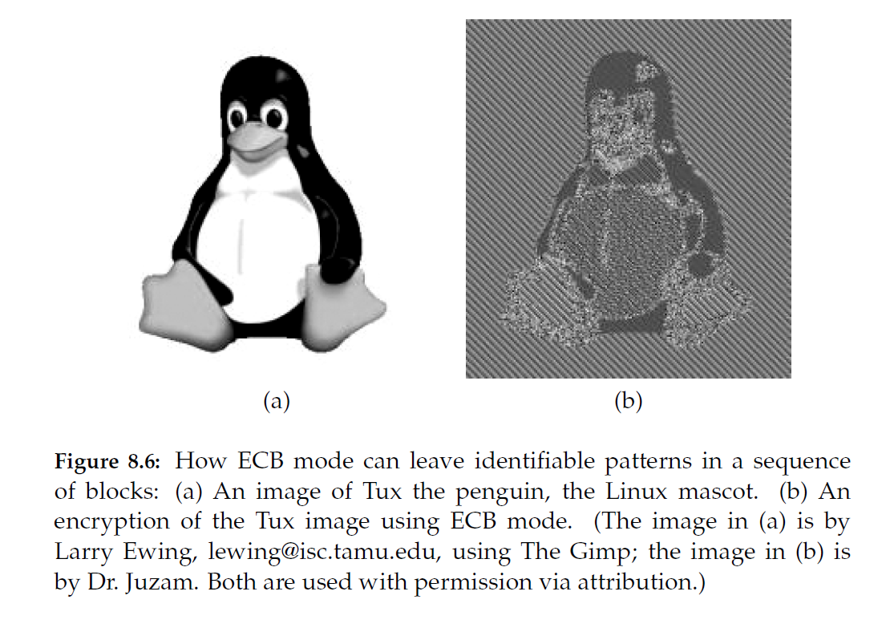
Strengths and Weaknesses of ECB
Strengths:
Is very simple
Allows for parallel encryptions of the blocks of a plaintext
Can tolerate the loss or damage of a block
Weakness:
Many data (documents and images ) are not suitable for ECB encryption since patters in the plaintext are repeated in the ciphertext:
t=1
P(1) = “HTTP/1.1”
block
cipher
C(1) = “k329aM02”
…
t=17
P(17) = “HTTP/1.1”
block
cipher
C(17) = “k329aM02”

Slide 29
Cipher Block Chaining (CBC) Mode
In Cipher Block Chaining (CBC) Mode
The previous ciphertext block is combined with the current plaintext block C[i] = E_{K} (C[i −1] ⊕ P[i])
C[−1] = V, a random block separately transmitted encrypted (known as the initialization vector)
Decryption: P[i] = C[i −1] ⊕ D_{K} (C[i])
CBC Encryption:
CBC Decryption:
P[0]
P[1]
P[2]
P[3]
P[0]
P[1]
P[2]
P[3]
V
V
E_{K}
E_{K}
E_{K}
E_{K}
D_{K}
D_{K}
D_{K}
D_{K}
C[0]
C[1]
C[2]
C[3]
C[0]
C[1]
C[2]
C[3]

Slide 30
Strengths and Weaknesses of CBC
Strengths:
Doesn’t show patterns in the plaintext
Is the most common mode
Is fast and relatively simple
Weaknesses:
CBC requires the reliable transmission of all the blocks sequentially
CBC is not suitable for applications that allow packet losses (e.g., music and video streaming)

Slide 31
Stream Cipher
Key stream
Pseudo-random sequence of bits S = S[0], S[1], S[2], …
Can be generated on-line one bit (or byte) at the time
Stream cipher
XOR the plaintext with the key stream C[i] = S[i] ⊕ P[i]
Suitable for plaintext of arbitrary length generated on the fly, e.g., media stream
Synchronous stream cipher
Key stream obtained only from the secret key K
Independent with plaintext and ciphertext
Works for high-error channels if plaintext has packets with sequence numbers
Sender and receiver must synchronize in using key stream
If a digit is corrupted in transmission, only a single digit in the plaintext is affected and the error does not propagate to other parts of the message.

Slide 32
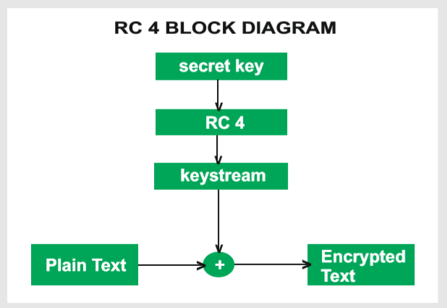
Key Stream Generation
RC4
Designed in 1987 by Ron Rivest for RSA Security
Trade secret until 1994
Uses keys with up to 2,048 bits
Simple algorithm

Slide 33
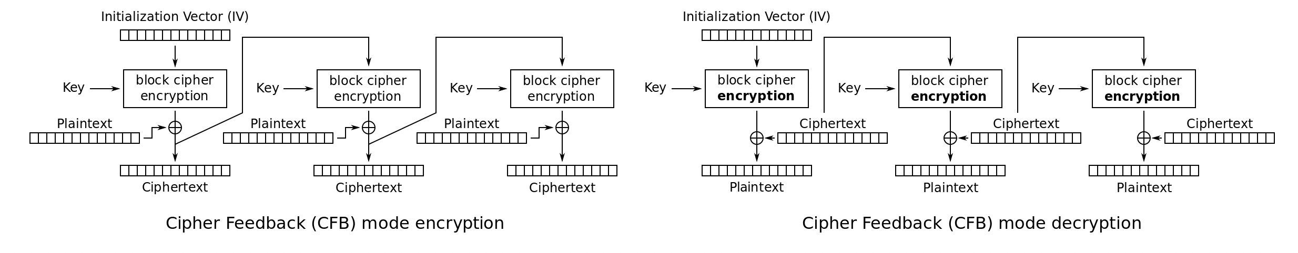
Self-synchronizing (or asynchronous) stream cipher
Key stream obtained from the secret key and N previous ciphertexts
The receiver will automatically synchronize with the keystream generator after receiving N ciphertext digits, making it easier to recover if digits are dropped or added to the message stream.
Single-digit errors are limited in their effect, affecting only up to N plaintext digits.

Slide 34
Attacks on Stream Ciphers
Repetition attack
if key stream reused, attacker obtains XOR of two plaintexts (why?)

